Slide 1
Our Journey: From Homegrown Card System to Vendor Based Solution
Dr. Gregory Jonason
Rosie Ashley
University of Houston
Notes:
Greg
Hello everyone! We’re going to be talking about our experience of transitions from a homegrown card system to a vendor-based solution.
We want to hear from you as well so feel free to interrupt to ask questions or share your ideas.

Slide 2
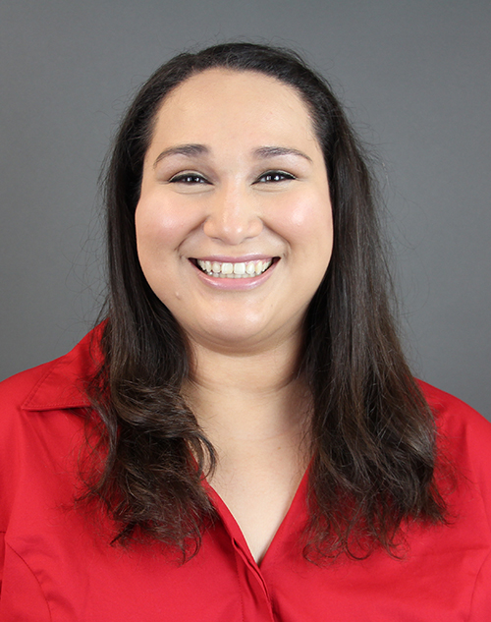
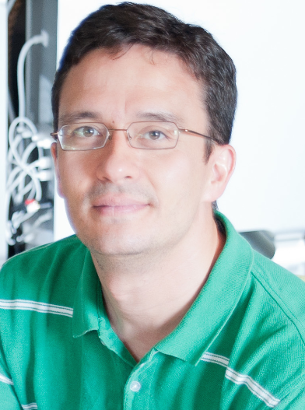
Meet the Team!
Manages for the Food Service contract for the UH System
Rosie Ashley
Program Director
Auxiliary Services
Dr. Gregory Jonason
Application Developer
Enterprise Systems
Notes:
Need to add more to this slide

Slide 3
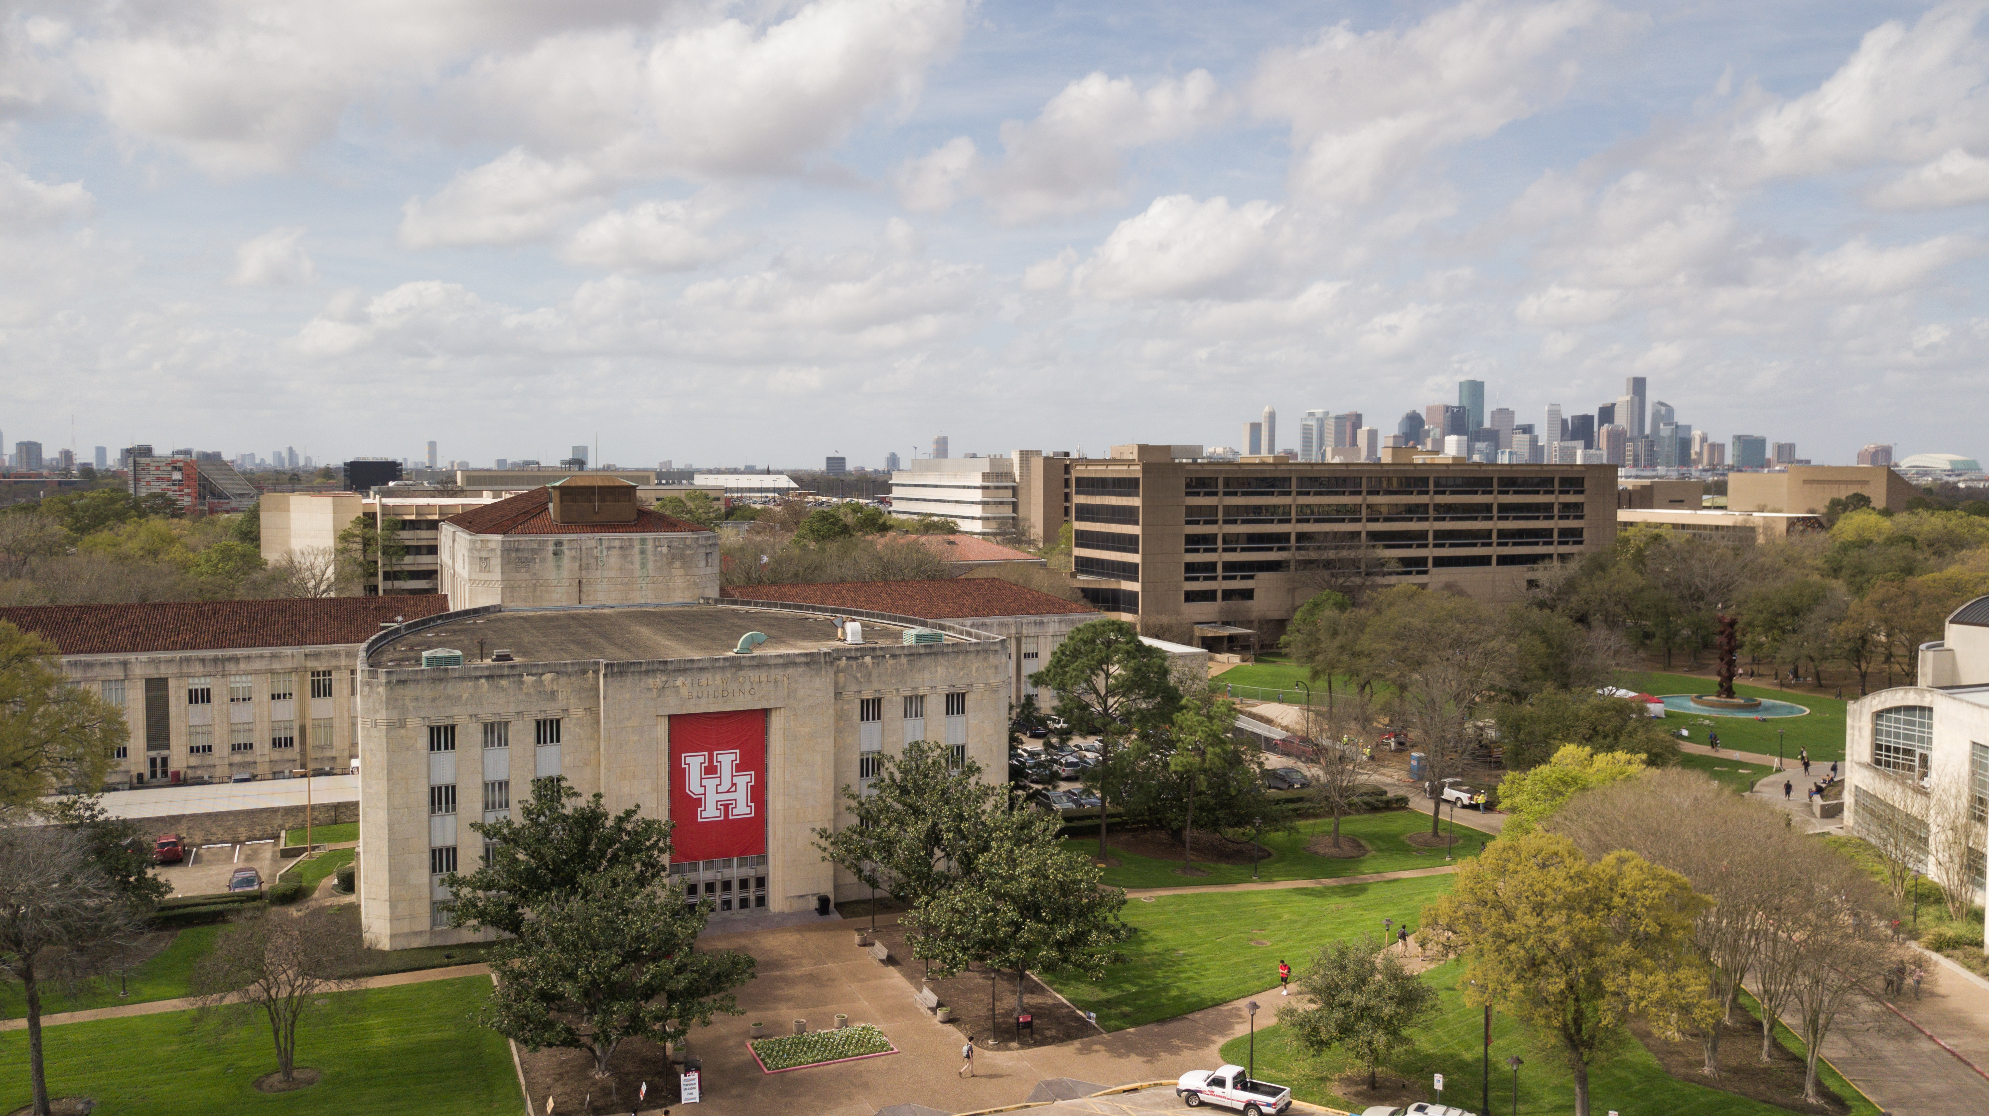
University of Houston
Founded in 1927
667-acre university located just south of downtown Houston
Third largest university in Texas
45,000+ Students
One of the most diverse universities in the nation with students from over 130 countries
Notes:
Rosie

Slide 4
Objectives
Planning your implementation and roll-out
Communication and support strategies with vendors
Managing day-to-day operations and new developments during implementation process
Notes:
Still need to work on this

Slide 5
Key Stakeholders
Office of Administration
University Services
Auxiliary Services
UH Central IT
Cougar Card Office
UH Dining Services
Notes:
Rosie

Slide 6
2007-2012
Industry Card System
August 2012 Implement homegrown card system
Dec. 2017 Vendor selected to support both systems
July 2017 RFP for new card system and POS
March2018: Contract with new vendor signed
July 2018: Implementation of new industry support system
Notes:
2007-2012: UH utilizes industry card system
August 2012:UH develops homegrown card system
July 2017: UH puts out RFP for new card system and POS
December 2017: Selection of vendor to support both systems
March 2018: Contract with new vendor signed (need to verify if this is accurate)
July 2018: Implementation of new industry support system

Slide 7
Why?
Keep up with technology for both ID and POS systems.
Future proof our systems
More robust reporting
Notes:
Greg

Slide 8

Notes:
Rosie

Slide 9
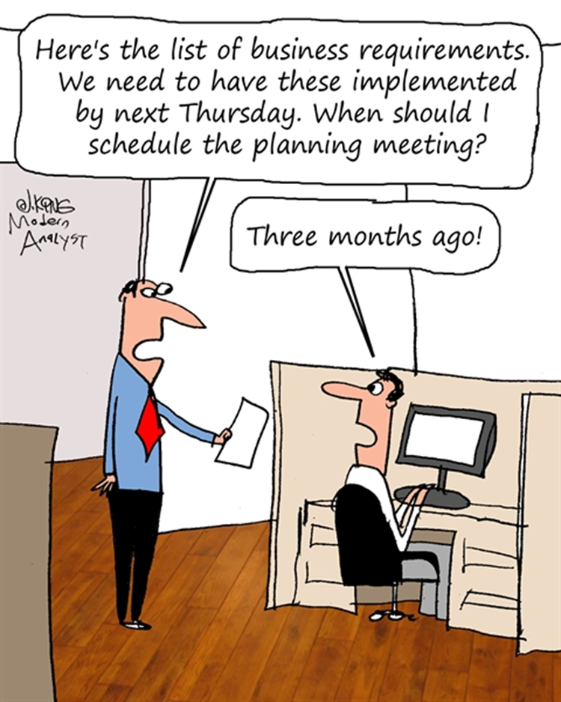
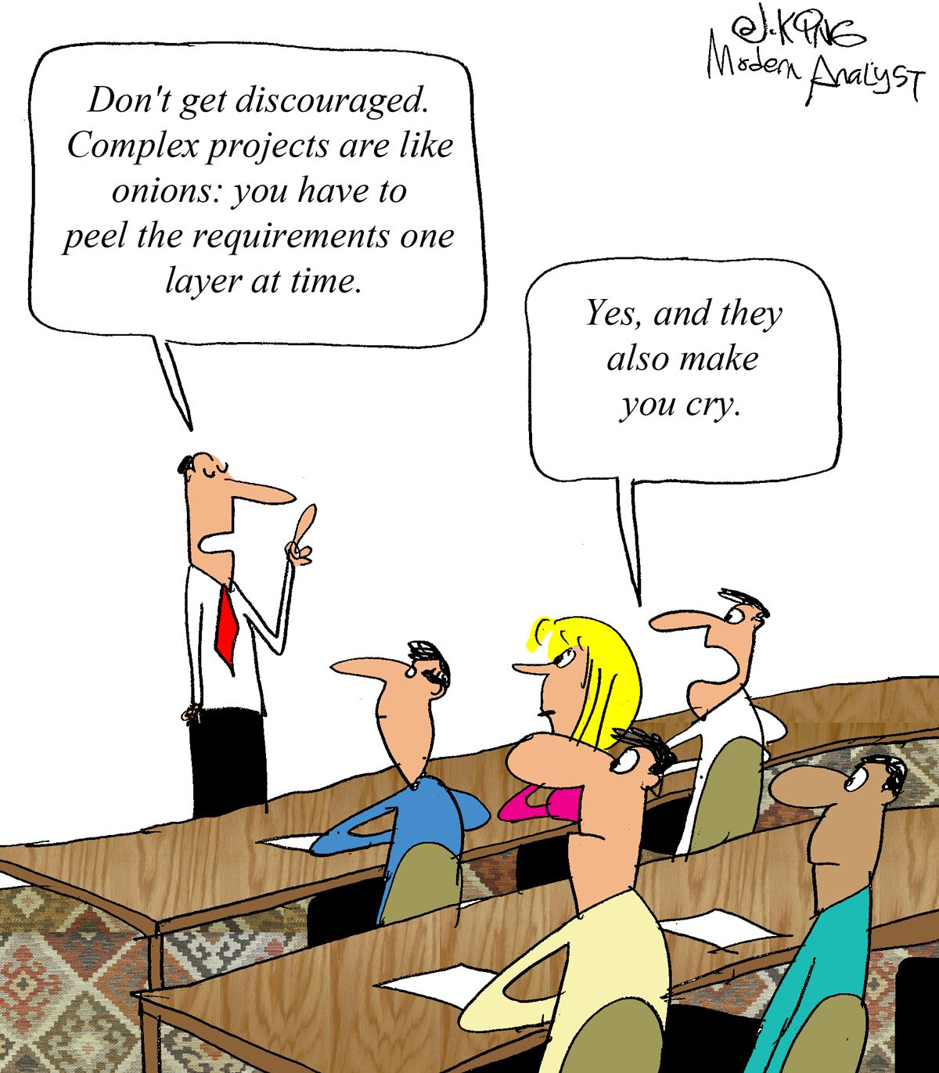
Notes:
Obstacle-New System & Quick Timeline
This was a completely new system (training, workflows, operations)
Opening Fall Semester with a complete cutover
Lesson Learned

Slide 10
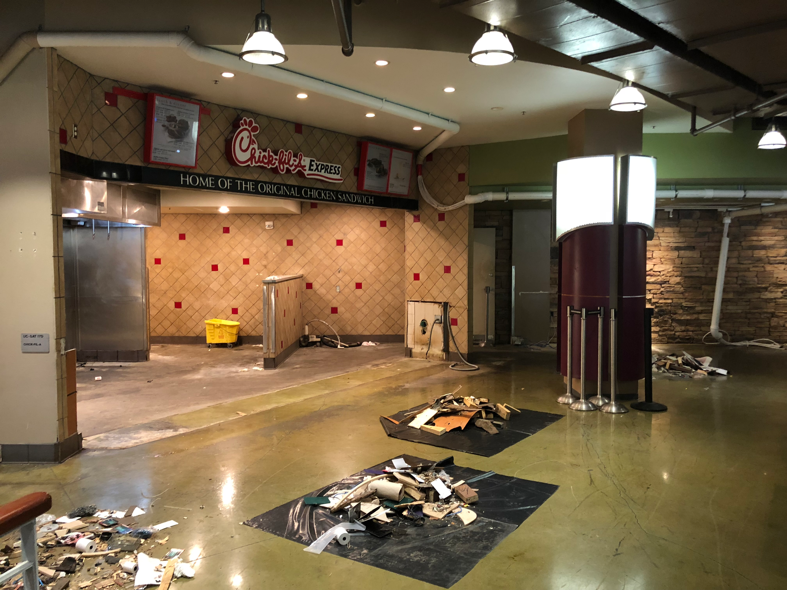
Notes:
Obstacle-Unprecedented impacts of flooding from Hurricane Harvey
There was also a flood, which took out our West Side of Campus dining facilities
Lesson Learned

Slide 11
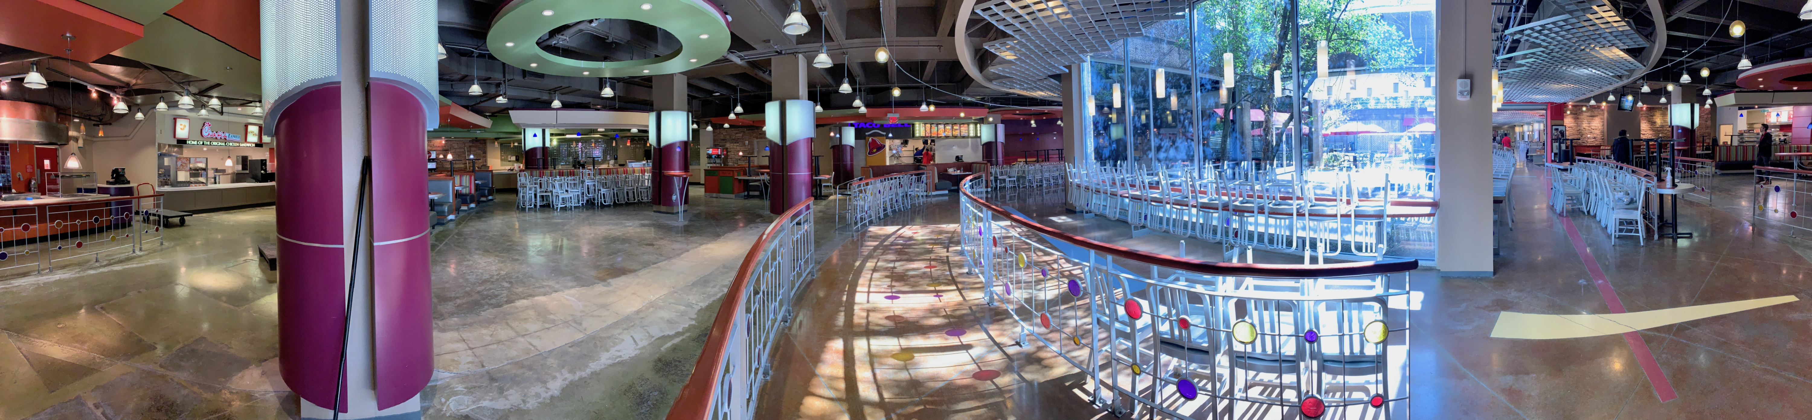
Notes:
Obstacle-Unprecedented impacts of flooding from Hurricane Harvey
There was also a flood, which took out our West Side of Campus dining facilities
Lesson Learned

Slide 12

Notes:
Obstacle-New Hire
New hire in the Project Management Role

Slide 13

Notes:
Rosie
Obstacle-Many new relationships had to be established…quickly
Many long meetings, late night work hours, etc. established the relationships.
We would email, call, text, meet in person, and meet virtually to make deadlines.
Lesson Learned

Slide 14
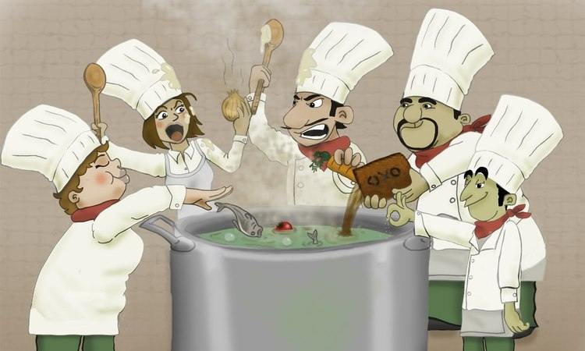
Notes:
Thought it would be good to use. “Too many cooks in the kitchen” can relate to the all the stakeholders that needed to be part of this project.

Slide 15

Notes:
Greg
Obstacle-Many new relationships had to be established…quickly
Defining the relationships as we went along helped to establish roles and responsibilities…it’s not easy!
Lesson Learned

Slide 16

Notes:
Greg
llustration-Business Partner/Vendor Relationship
What happens if either one lets go? In order to succeed, we must rely on each other.
Lesson Learned

Slide 17
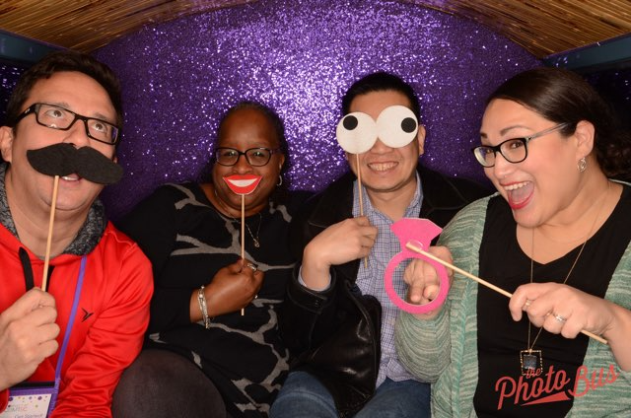
Notes:
Greg
Illustration-Internal Stakeholders and Support
Conference together.
This shows members of Auxiliary Services, University Services, and Central IT getting along and having a good time.
If we can do it, so can you!
Unity and cohesion can help overcome a lot of stress and keep the lines of communication open between various groups on campus.
Silos are no fun.
Lesson Learned

Slide 18
Note: Quickly Recap Lessons Learned to Conclude Presentation
Notes:
Greg & Rosie

